Slide 1
BIODIVERSITY

Slide 2
WHAT IS BIOLOGY ?
Greek Word: Bios = life
logos = study
It is study of life/living organisms
Living organisms -
(i) growth
(ii) response to stimuli
(iii) reproduction
(iv) capable of surviving through self
regulatory mechanisms etc...

Slide 3
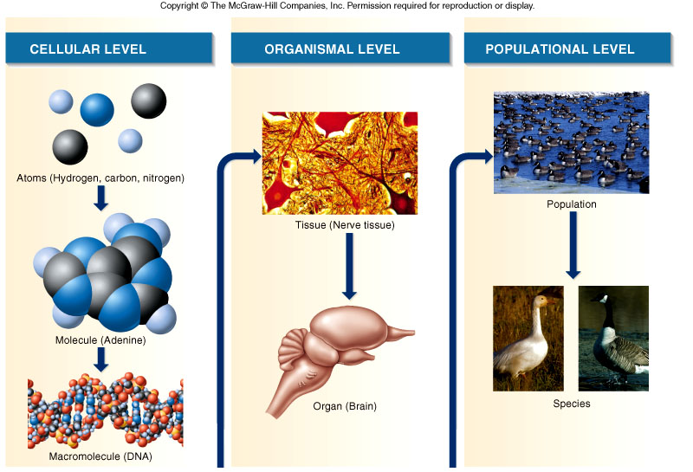
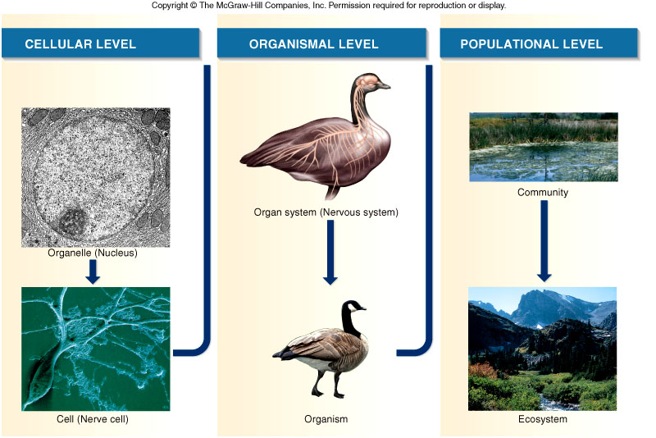

Slide 6
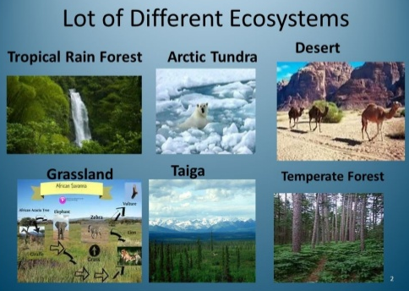
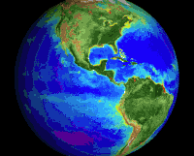

Slide 7
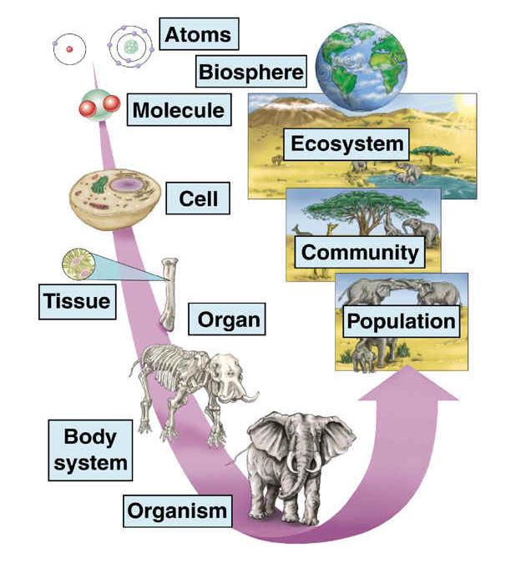
Individuals make up a population.
Populations make up a species.
Multiple species and their interactions make up a community.
Community + abiotic factors make up an ecosystem.
Different ecosystems make up biosphere.
This is the hierarchy of ecology.

Slide 8
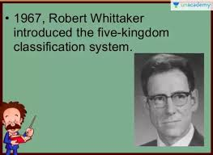
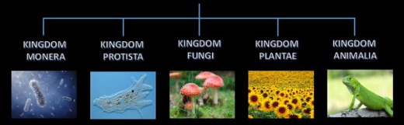
Classification of living organisms
In 1969, Robert Whittaker introduced the five kingdom classification system
LIVING ORGANISMS
Prokaryotic | Eukaryotic | Eukaryotic | Eukaryotic | Eukaryotic
Unicellular | Unicellular | Mostly multicellular | Multicellular | Multicellular
Autotrophs / Heterotrophs | Autotrophs / Heterotrophs | Heterotrophs (Saprotrophs) | Autotrophs | Heterotrophs
Bacteria | Amoeba | Yeast, Mushroom | Plants | Animals

Slide 9
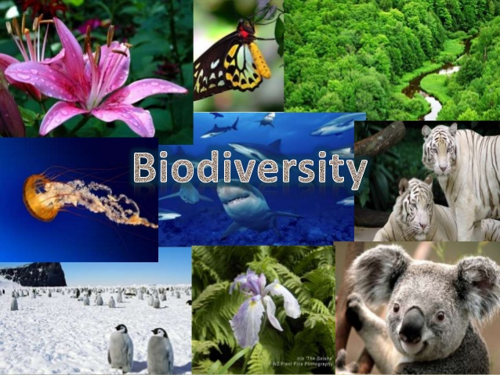

Slide 10
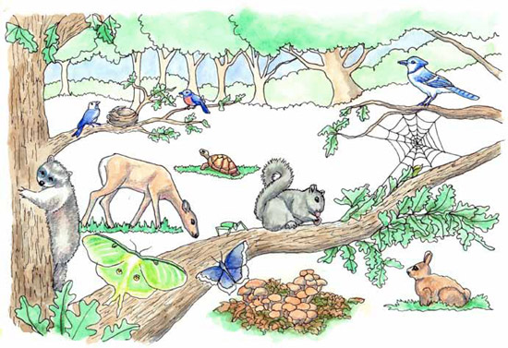
BIODIVERSITY OF LIVING WORLD
Biodiversity is the variety of life on Earth

Slide 11
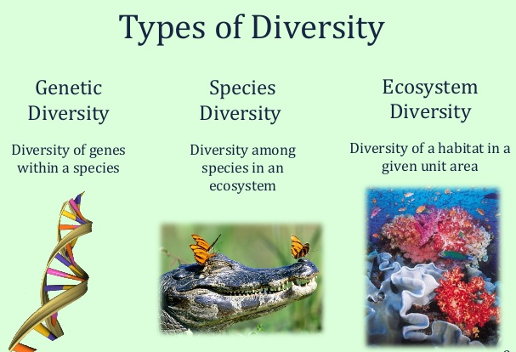

Slide 12
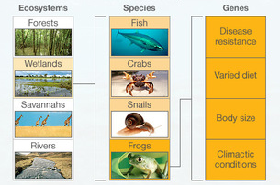

Slide 13
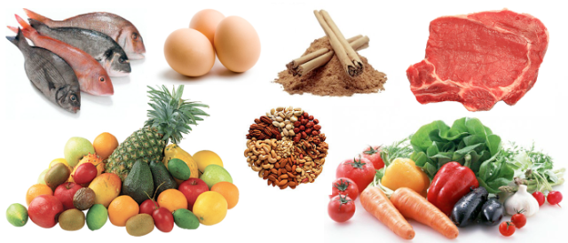
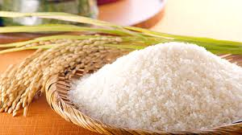

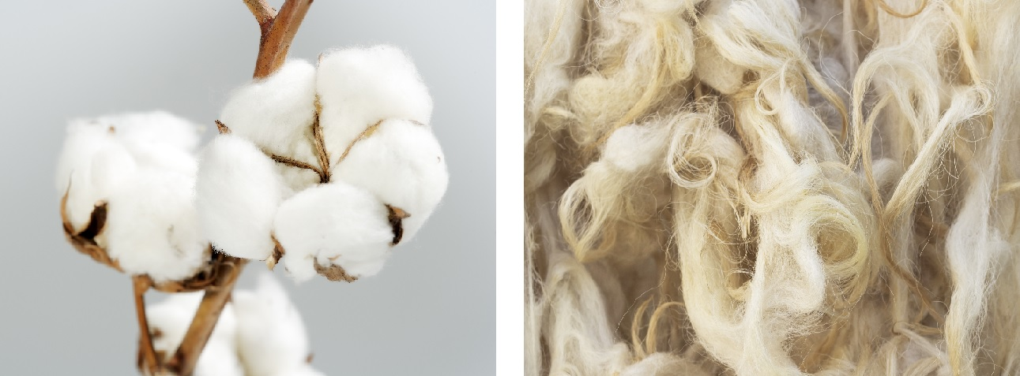
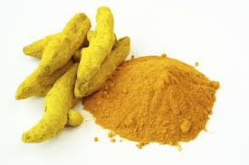
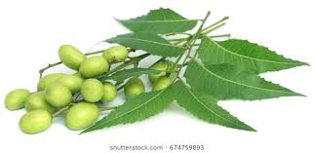
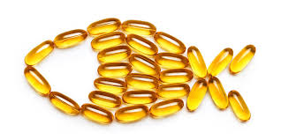
IMPORTANCE OF BIODIVERSITY
1. Food
2. Shelter and warmth
3. Medicines

Slide 14
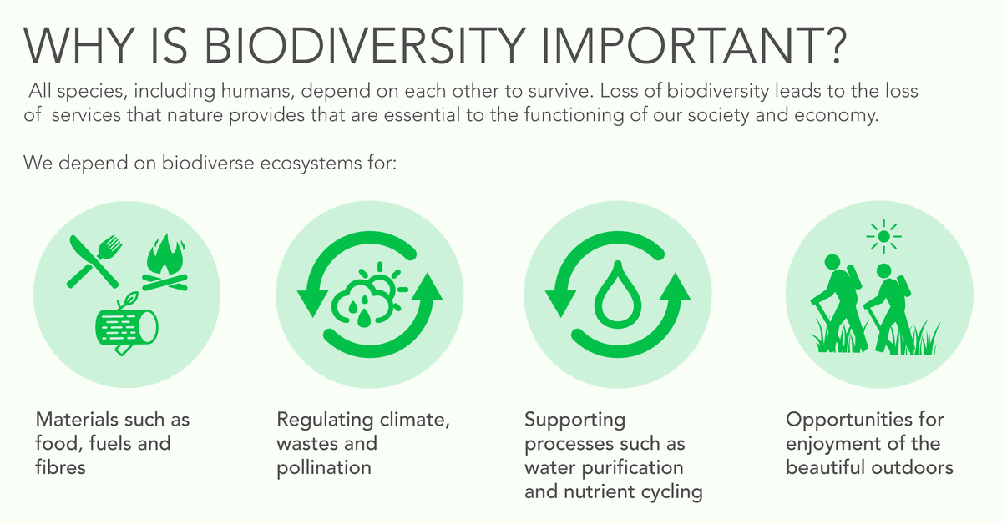

Slide 15
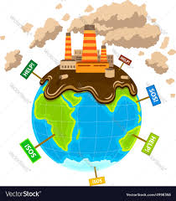
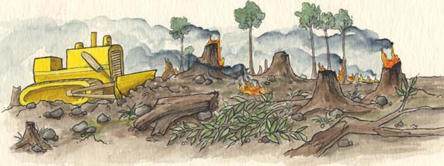
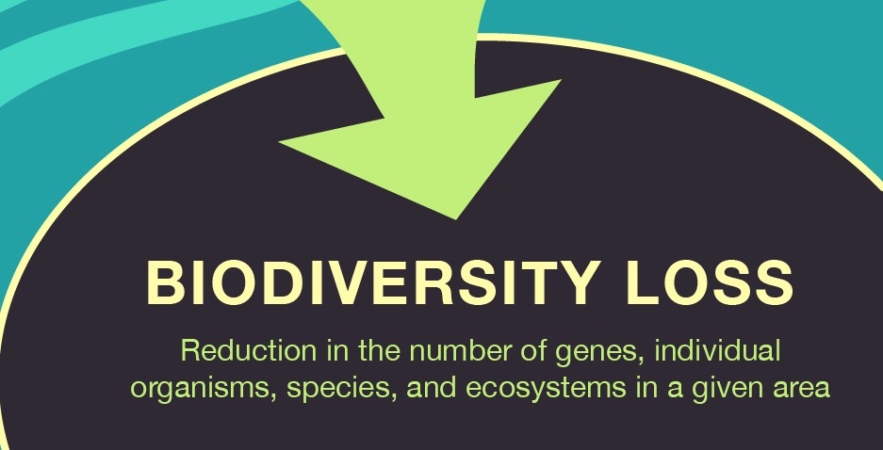
THREATS TO BIODIVERSITY
1. Habitat loss and destruction
2. Alterations in ecosystem composition
Deforestration
Pollution
3. Introduction of exotic species
4. Over-exploitation of species
5. Pollution and contamination
6. Global climate change

Slide 16
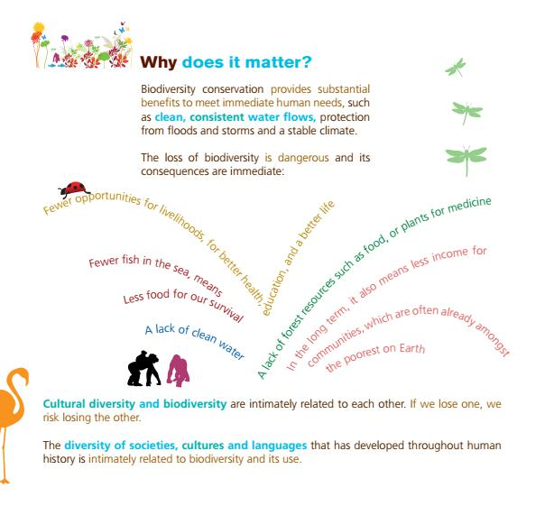
BIODIVERSITY CONSERVATION
Lack of forest resources, food or plants for medicine
Fewer opportunities for livelihoods, for better health, education and a better life
Lack of clean water

Slide 17
SOLUTIONS
Green Economy Initiative
Promoting increase in protected areas
Focus on implementation of Environmental Programmes
Increasing communication, education and public awareness
Identifying and creating opportunities for rural enterprises based on biodiversity
Encouraging development that is sustainable and based on biodiversity

Slide 18
IMPORTANT QUESTIONS
What is biodiversity? What are the three levels of biodiversity?
Why is biodiversity so important?
State the various threats to biodiversity.
Describe the five kingdoms of classification with examples.
Describe how Monera is different from Plantae.

